Slide 1
Deep Dive into Active Learning
Train neural networks more efficiently with less data
Christian Normand

Slide 2

Roadmap
Introduce problem statement
Define active learning
Review experiment
Discuss results
Reflect on lessons learned

Slide 3

Read this book
Human-in-the-Loop Machine Learning
By Robert (Munro) Monarch.
This book provided the inspiration for this project. It’s all about active learning, and more generally, how humans and machine learning algorithms interact.
Check it out here!

Slide 4
Problem statement: Can active learning techniques be used to reduce the amount of training images required for a convolutional neural network (CNN) to reach target accuracy?

Slide 5
Define Active Learning

Slide 6

Active learning: What is it?
Supervised learning requires labeled data.
Active learning comprises a set of techniques for selecting the data you will use to train your model.
Allows you to reach target accuracy with fewer labeled data points.
Can be used to periodically retrain models to adapt to changing data.

Slide 7








Example: Consider a blogging website that’s trying to detect aggression in its comment section.
A traditional approach to labeling data might look like this:
(a) aggressive
(b) not aggressive
Data scientists sample comments from a large collection of blog posts
Comments are selected at random
Annotators label each comment as aggressive or not aggressive
Data scientists train a model using the labeled data

Slide 8
Example: Consider a blogging website that’s trying to detect aggression in its comment section.
An active learning approach
would look more like this:
(a) aggressive
(b) not aggressive
Annotators label each comment as aggressive or not aggressive
Data scientists train a model using whatever labels they have
Data scientists sample comments from a large collection of blog posts
A small batch of comments is selected at random
Data scientists intelligently select the next batch of samples to annotate based on results from the model

Slide 9
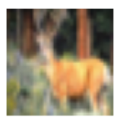
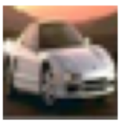
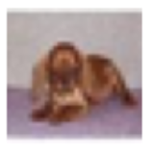
Active learning techniques
Uncertainty sampling
Sampling data that’s most confusing for the model.
Input
Model says:
91% sure that’s a deer.
99% sure that’s a car.
51% sure that’s a cat…
but maybe it’s another deer.

Slide 10
Active learning techniques
Uncertainty sampling
Sampling data that’s most confusing for the model.
Input
Model says:
91% sure that’s a deer.
99% sure that’s a car.
sample
this →
51% sure that’s a cat…
but maybe it’s another deer.

Slide 11
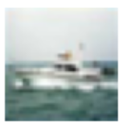
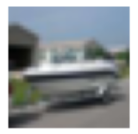
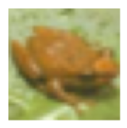
Active learning techniques
Uncertainty sampling
Sampling data that’s most confusing for the model.
Diversity sampling
Sampling data that’s the most different from what the model has already seen.
Input
Model says:
Input
Model says:
91% sure that’s a deer.
That’s a boat!
99% sure that’s a car.
That’s another boat!!!
51% sure that’s a cat…
but maybe it’s another deer.
That’s a frog… but I haven’t
seen many frogs before

Slide 12
Active learning techniques
Uncertainty sampling
Sampling data that’s most confusing for the model.
Diversity sampling
Sampling data that’s the most different from what the model has already seen.
Input
Model says:
Input
Model says:
91% sure that’s a deer.
That’s a boat!
99% sure that’s a car.
That’s another boat!!!
51% sure that’s a cat…
but maybe it’s another deer.
That’s a frog… but I haven’t
seen many frogs before
sample it.

Slide 13
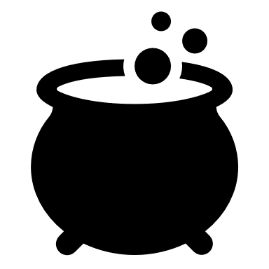
Combining techniques
Use uncertainty sampling to find the 1,000 most confusing images.
From these images, apply diversity sampling to pick 90 that provide a diverse representation of your sample space.
Use random sampling to pick the final ten images.

Slide 14
Review experiment

Slide 15
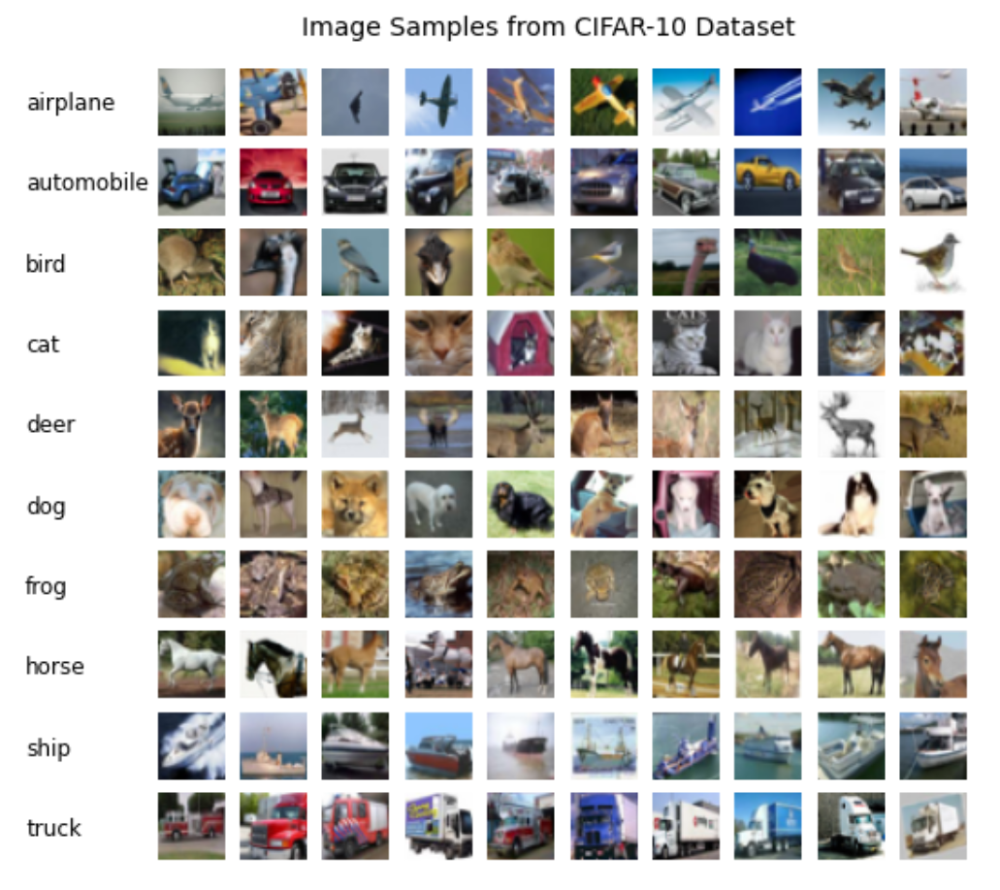
The CIFAR-10 Dataset
60,000 tiny images evenly split into ten categories
I used 49,000 for training, 1,000 for validation, and 10,000 for testing.
This is a commonly used dataset for image classification. There are plenty of models out there that have achieved ~90% accuracy.

Slide 16
The model
I used a convolutional neural network with one hidden layer.
The model maxed out at 50% accuracy.
I chose a simpler model to see if it would be faster to train, acknowledging it could impact accuracy.
Convolutional 2D layer
Convolutional 2D layer
Max pooling layer
Flatten
Dense 128 neuron layer
10 neuron output (softmax)

Slide 17

Methodology
Try different percentages of uncertainty sampling [0%, 10%, 20%... 100%], and see how that affects the time it takes for the model to reach 50% accuracy.
Diversity sampling would have been interesting to implement as well, but I did not have time.
Start each trial by training the model on a randomly selected batch of 1,000 images.

Slide 18
Methodology (continued)
After the first training batch, use the uncertainty sampling protocol for that trial to add another 1,000 images to the training set.
I used margin of confidence to rank images by their level of uncertainty.
Retrain the model and repeat until the training set includes all 49,000 training images.
Run three trials for each sampling protocol.

Slide 19

Concern: Speed
The experiment consisted of 1,600+ CNNs.
Using a GPU or TPU would have been ideal but was not an option.
My laptop

Slide 20
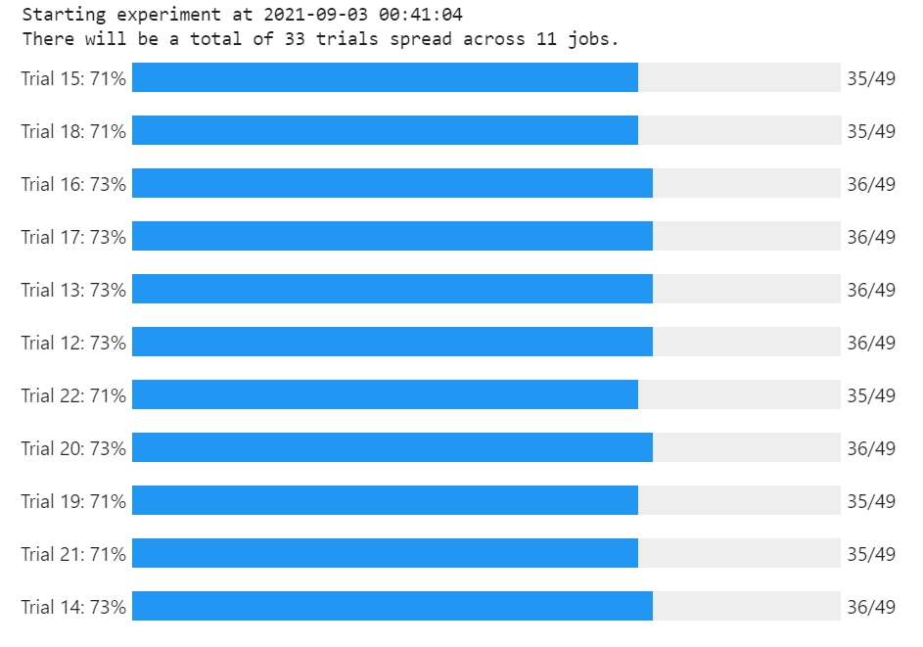
Solution: Multiprocessing
I refactored my code using the multiprocess package and ran the experiment in a Google AI notebook with 16 CPUs

Slide 21
Discuss results

Slide 22
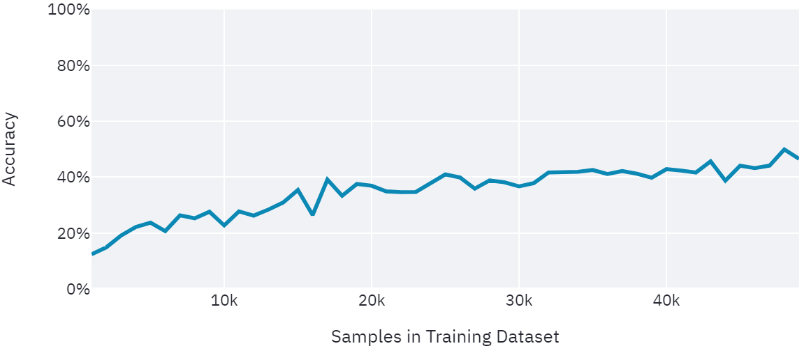
Baseline
Random Sampling Only
50% Accuracy

Slide 23
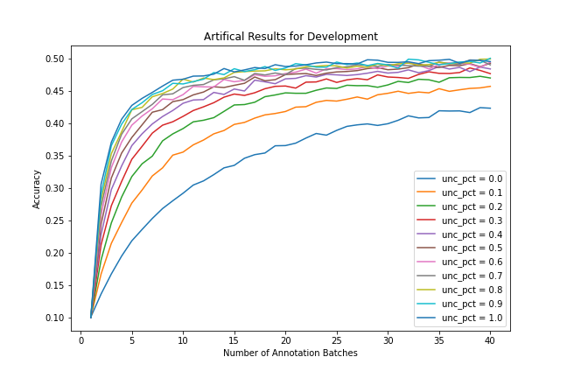
Results…?
I derived a formula to generate dummy results so I could start working on charts while the experiment was running.
This is what I hoped the results would look like.

Slide 24
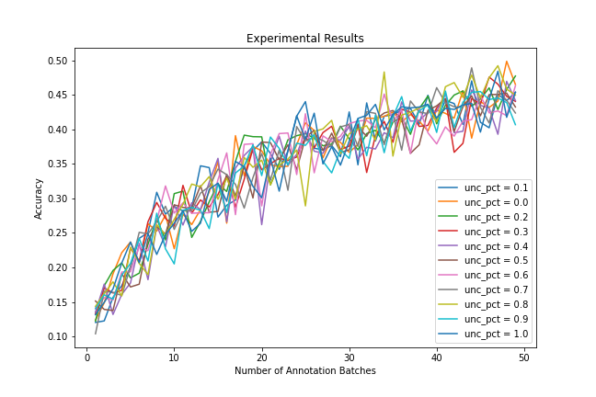
Results
I derived a formula to generate dummy results so I could start working on charts while the experiment was running.
This is what I hoped the results would look like.
This is what the results actually looked like.

Slide 25

Why the unexpected outcome?
First guess: The model wasn’t strong enough.
Second guess: A different method of uncertainty sampling might have led to better performance.
Third guess: Incorporating diversity sampling might have led to better performance.

Slide 26
Reflect on lessons learned

Slide 27

Accomplishments
Created an object-oriented framework for running iterative experiments using any type of model.
Learned how to use the multiprocessing package and Google AI notebooks.
Continuing to learn about active learning, a very useful technique in industry.

Slide 28
Improvements for week 13
Run the experiment with a better model
Implement diversity sampling
Adjust annotation batch size for faster training

